Slide 1
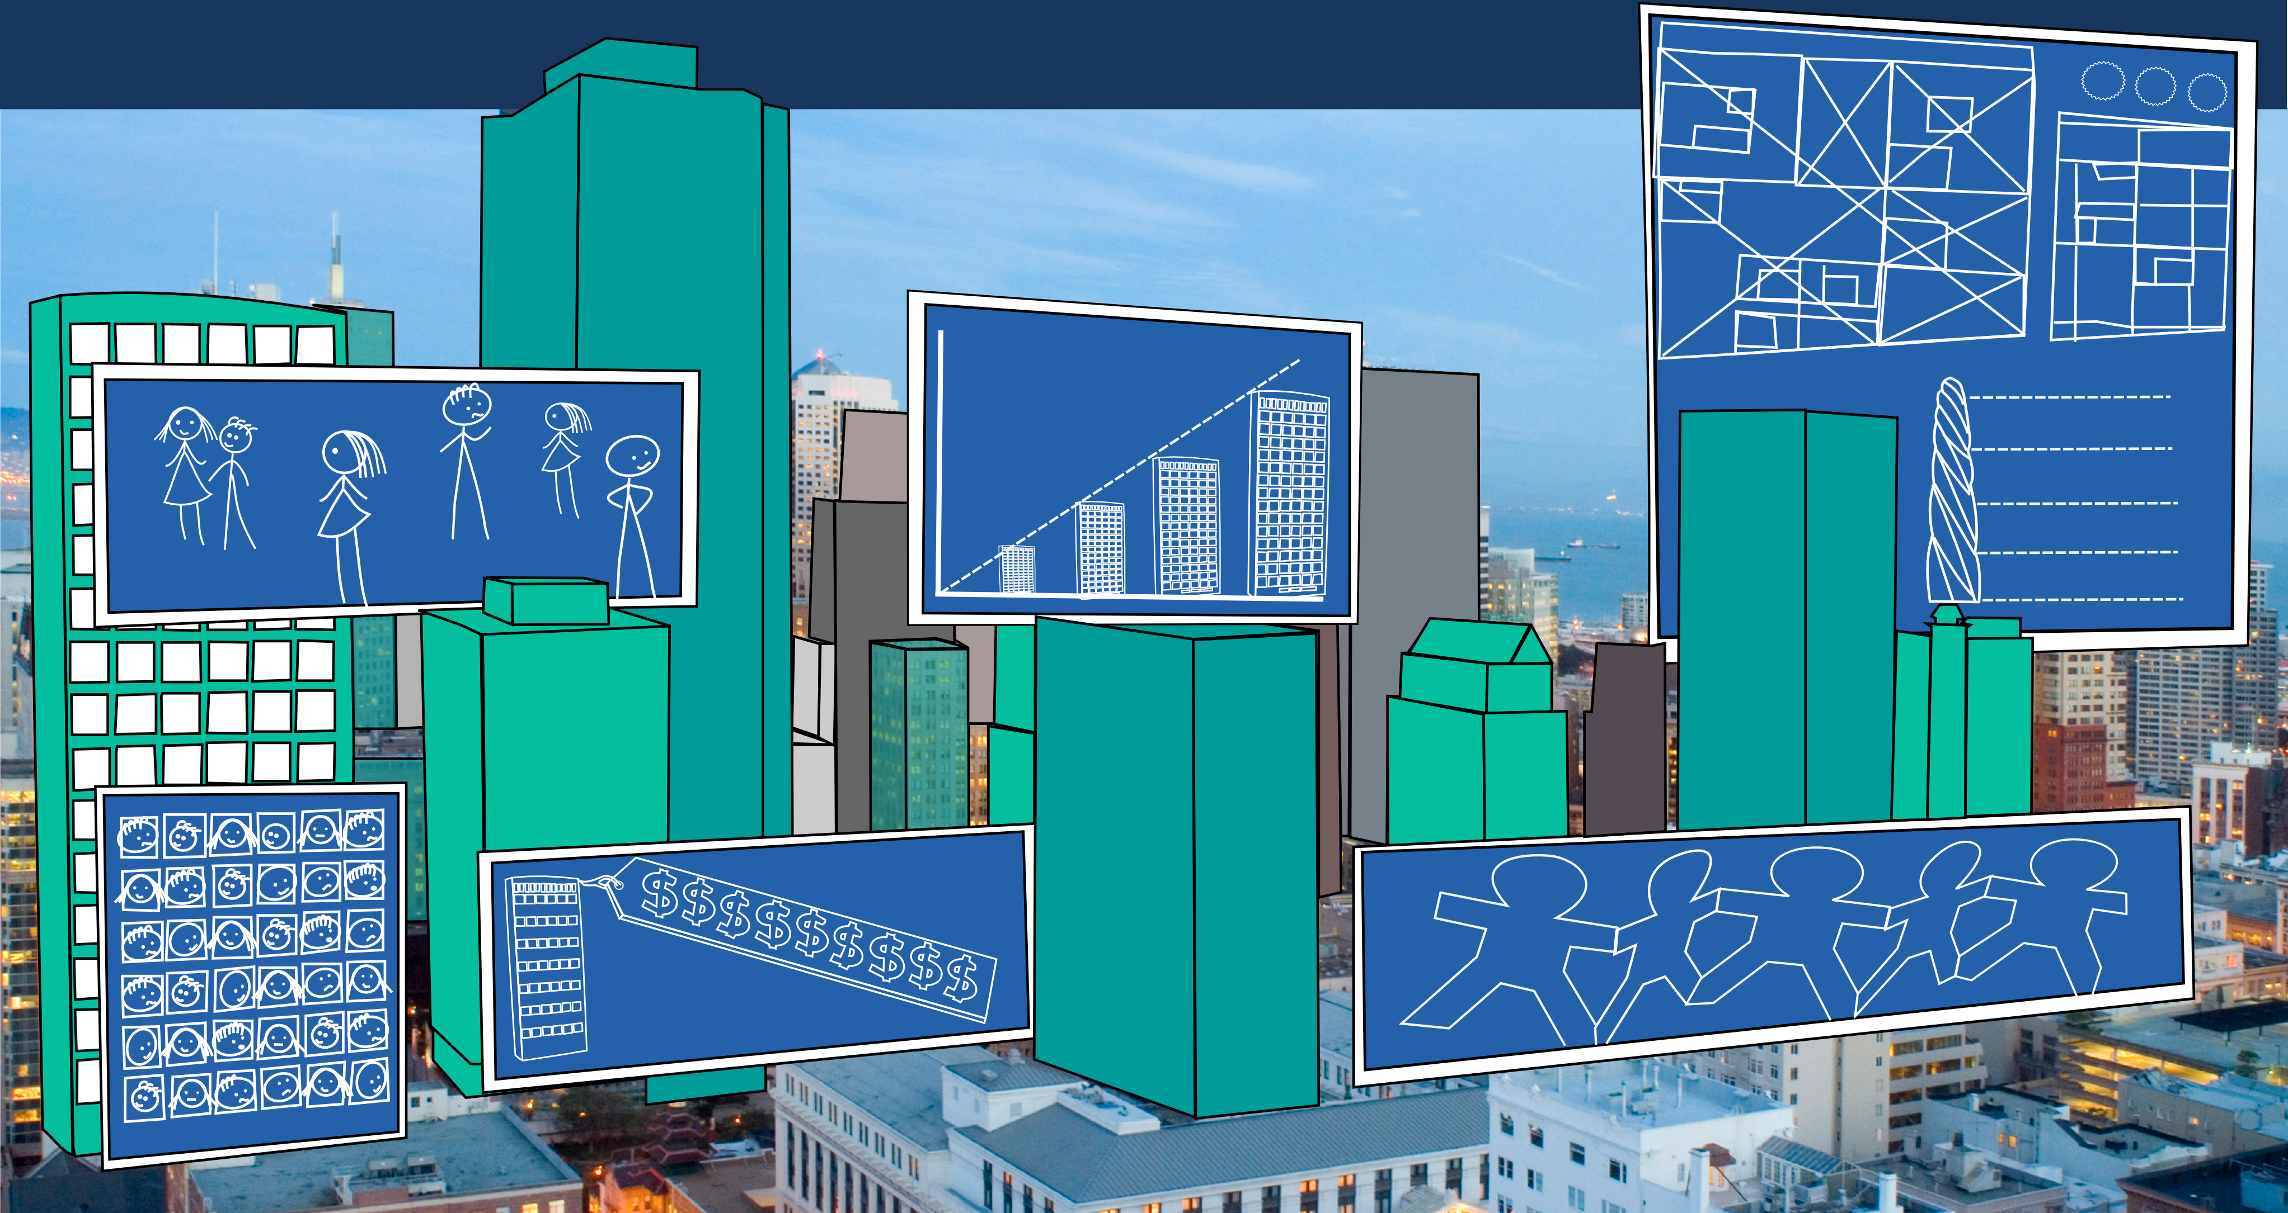

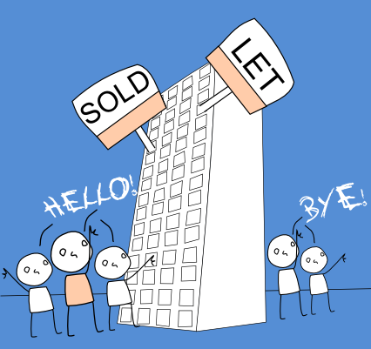

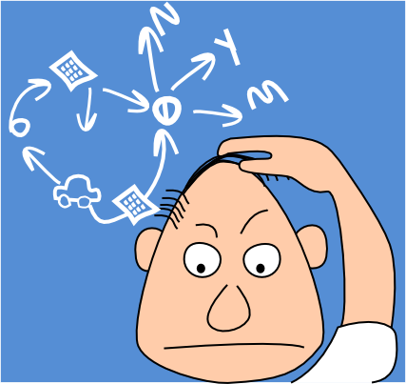

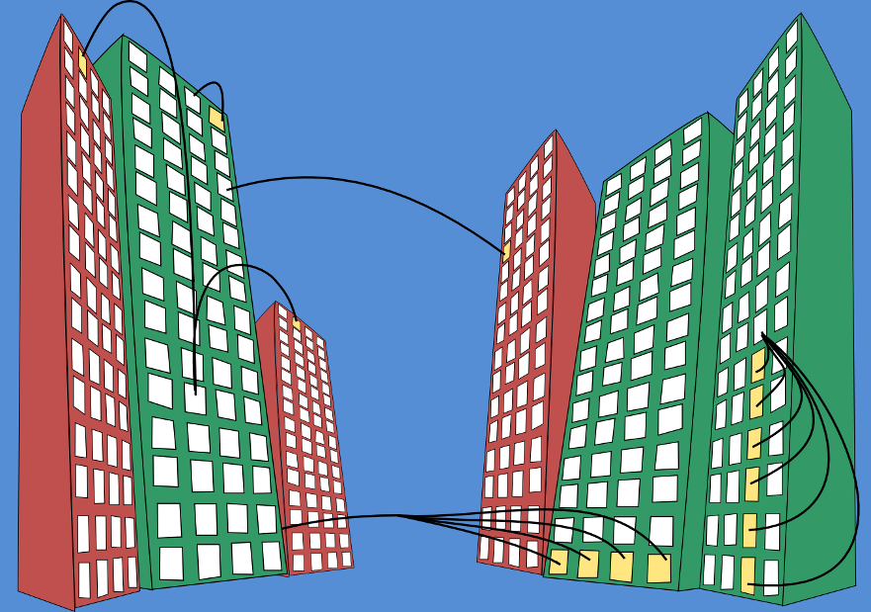

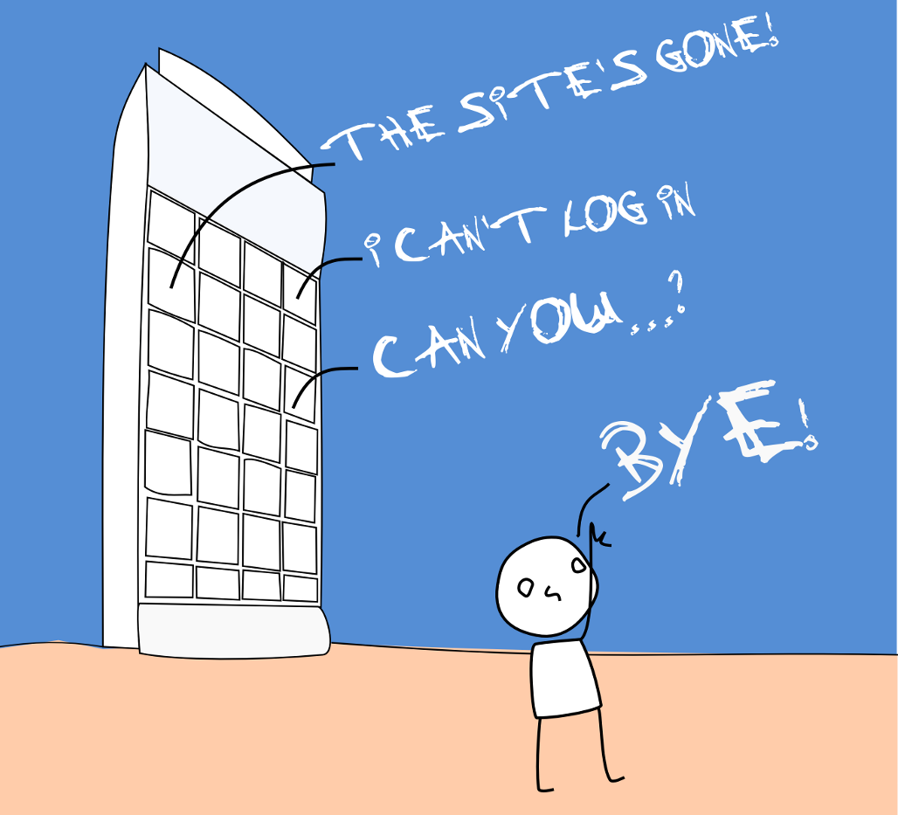






Communities in the Clouds
support for high-rise living
complex
Why are high-rises interesting?
Residents can find themselves knee-deep in the complex technical, structural, legal and operational details that are commonly associated with high-rises.
on the increase
In London, between 2004 and 2007, there was a 740%* increase in plans for properties over 35 floors. Governments and developers love them.
Residents may meet more people but will know fewer.*
*Create Streets (2013) Policy Exchange, p.17
impersonal
* Create Streets (2013), Policy Exchange p. 33
High-rises cost millions to build and maintain. ‘Iconic’ buildings have an estimated 36% premium* due to ‘aspect, privacy and exclusivity’.
Tenants, landlords, freeholders, contractors management companies, local
Super-density buildings can contain thousands of people – ready made urban communities.
expensive
*CBRE UK Residential ViewPoint 2012
many stakeholders
businesses all have an interest in high-rises and their occupants.
high density
What are the challenges?
What do their residents need?
Online interaction is directly tied to homes and lives, implicating privacy.
Tenancy, ownership and affiliation with a high-rise is fluid. Efficiently reflecting these changes in supporting systems is hard.
property
finance
WE must stop this NOISE!
maintenance
service charges
WE want FASTER broadband
insurance
upkeep
reserve funds
privacy
churn
WE need a NEW bike store
logistics
WE want to TAKE OVER management
health
&
safety
security
Residents may not like or trust each other. Disputes and aggression can severely impact current and future collaboration, even if mutually beneficial.
WE want to INSTALL cctv
legal
parking
contractors
Residents may need to understand complex technical, legal or infrastructural information and processes to accomplish goals.
collaboration
management
mail
inspections
infrastructure
Am I allowed to...?
animosity
What does the second light
next to the boiler do?
Who do I talk to about..?
complexity
High-rise properties are mired in complex legal, technical and operational data, all often held across multiple silos.
How are our energy costs calculated?
The neighbours above me have...
Residents and companies often manage or own supporting systems. This is rarely sustainable.
Who does the best ....?
Where can I get replacement x?
rules
How much do you pay for ...?
comparisons
The front only opens if you pull it back hard first.
communication
knowledge
Don’t walk through x after 7pm
High competition for parking
experience
sustainability
opacity
Current online landscape
Research questions
knowledge
High-rise communities do not map well onto generic social platforms. Nextdoor offers ‘neighbourhood social networking’, but it too falls short of meeting the rich and complex requirements of high-rise residents. We require services and tools that are tailored to high-rises.
Are there a core set of ‘platform’ services that could encourage future innovation?
Can technology help residents take greater control of the evolution of their developments and neighbourhoods?
What is the role of the resident in designing and distributing new tools?
custom
tools
notification
auth
API
Information is harrd to obtain
data management
finance
communication
Toolsets are poor and socially motivated
social tools
How can technology better support the challenges of high-rise living?
repair and maintenance
These are often expensive proprietary systems with a management focus. They may expose limited functionality to residents (such as the ability to pay service charges) but they rarely offer support for residents to communicate, collaborate or retrieve detailed information. Management companies are wary of offering these features.
Negotiation and collaboration is challenging resulting from residents’ shared financial and emotional stakes in their buildings. Can this be reflected in the design of solutions?
Social networking can support and undermine collaboration. Is a social networking metaphor appropriate in this context?
Management companies rarely support online residential communities. How can moderation be built into tools and services in a fair and transparent way?
health & safety
adversarial
accounting
issue reporting
occupancy records
inspection scheduling
insurance
service charge collection
property management systems
How do the sociological / place-based characteristics implicate the design of solutions?
Tom Lodge
thomas.lodge@nottingham.ac.uk
Richard Mortier
richard.mortier@nottingham.ac.uk
Tom Rodden
tom.rodden@nottingham.ac.uk

